Slide 1

WIPRO NGA Program – 25SUB4530_CP_JAVA
Capstone Project Presentation – 9th Feb & 10th Feb 2026
Project Title Here – Online Book Store (Catalog Management System)
Presented by – Team 14
Pranav Bhatnagar 58684
Padala Manvitha 58679
www.rpsconsulting.in

Slide 2

Online Book Store (Catalog Management System)
Introduction :
The Online Book Store (Catalog Management System)is a web-based application developed to manage and display book information in an efficient and organized manner..
It replaces manual or spreadsheet-based book tracking with a centralized digital platform, enabling administrators to manage book details and users to easily browse and search available books.
The system is developed using Angular for the frontend and Spring Boot for the backend with REST APIs.
2024 - RPS Consulting all rights reserved

Slide 3
Online Book Store (Catalog Management System)
Problem Statement :
In many bookstores and libraries, book information is maintained manually or in basic systems, which leads to:
Difficulty in managing large volumes of book data
Slow and inefficient search process
Errors while updating book details
Lack of centralized and secure access
Poor user experience
There is a need for a structured and centralized catalog management system to efficiently manage and display book information.
2024 - RPS Consulting all rights reserved

Slide 4
Online Book Store (Catalog Management System)
Objectives:
The key objectives of the Online Book Store Catalog Management System are::
To maintain an organized book catalog
To enable fast searching of books
To allow administrators to update and manage book information
To provide a user-friendly and responsive interface
2024 - RPS Consulting all rights reserved

Slide 5
Online Book Store (Catalog Management System)
Core Functionalities:
The system provides the following core functionalities:
User registration and login
Add, update and delete book records by Admin
Search books by title or author
View book price and stock status
Input validation and proper error handling
All operations are performed using RESTful APIs, ensuring loose coupling between frontend and backend.
2024 - RPS Consulting all rights reserved

Slide 6
Online Book Store (Catalog Management System)
Key Features:
Role-based access for Admin and User
Fast and accurate book search
Secure data handling using backend validation
Real-time updates to book catalog
User-friendly interface using Angular
Stock availability indicator for each book
Scalable architecture for future modules like orders and payments
Clean separation of layers (Controller, Service, Repository)
2024 - RPS Consulting all rights reserved

Slide 7
Online Book Store (Catalog Management System)
RESTful API-Based Architecture:
The project follows a RESTful API architecture, where:
POST → Add new book
GET → View books(s)
PUT → Update book details
DELETE → Remove book
APIs return JSON responses
Stateless communication is maintained
Clear separation between frontend and backend
This architecture improves scalability, maintainability of the application.
2024 - RPS Consulting all rights reserved

Slide 8
Online Book Store (Catalog Management System)
Technology Stack:
1.Frontend
Angular
2.Backend 4. DevOps & Deployment
Spring Boot - Docker (Containerization)
Spring Data JPA - Microsoft Azure App Service
REST APIs
3.Database
MYSQL / PostgreSQL
2024 - RPS Consulting all rights reserved

Slide 9
Online Book Store (Catalog Management System)
System Roles:
Admin:
Add, edit and delete books
Manage complete book catalog
User:
view available books
Search books by title or author
Role –based dashboards are provided for both Admin and User
2024 - RPS Consulting all rights reserved

Slide 10
User searches and views books
Online Book Store (Catalog Management System)
Application Workflow:
User opens the application:
User opens the application
User registers or logs in
User or Admin accesses their dashboard
User searches and views books
Admin adds, edits or deletes book records
Frontend performs validation
Data is sent to backend REST APIs
Backend processes and stores data in the database
Book list is refreshed automatically
2024 - RPS Consulting all rights reserved

Slide 11
Online Book Store (Catalog Management System)
DevOps & Deployment:
Docker:
Containerizes frontend and backend applications
Ensures consistent environment across development and production
Simplifies deployment process
Azure:
Hosts backend Spring Boot APIs
Hosts Angular frontend application
Supports scalability and cloud deployment
Enables easy application management.
2024 - RPS Consulting all rights reserved

Slide 12
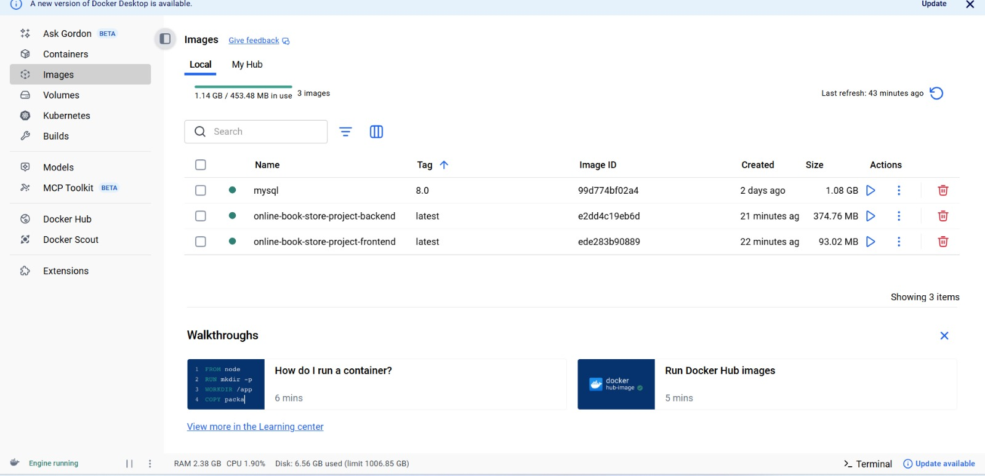
Online Book Store (Catalog Management System)

Slide 13
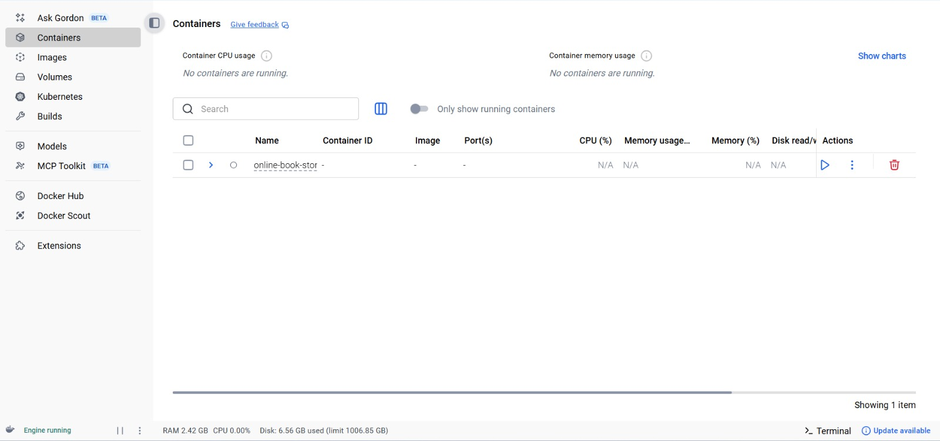
Online Book Store (Catalog Management System)

Slide 14
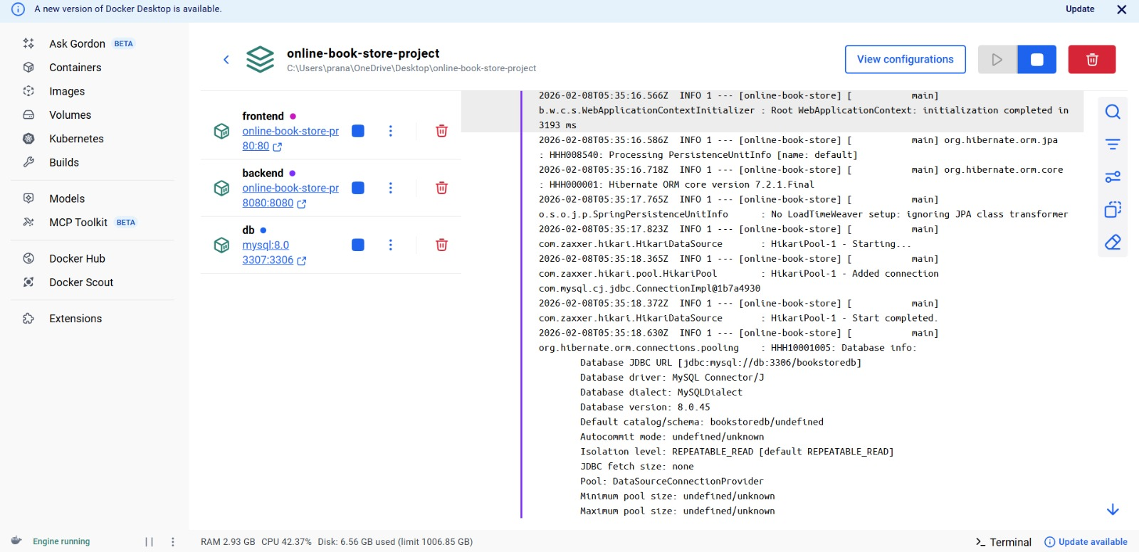
Online Book Store (Catalog Management System)

Slide 15
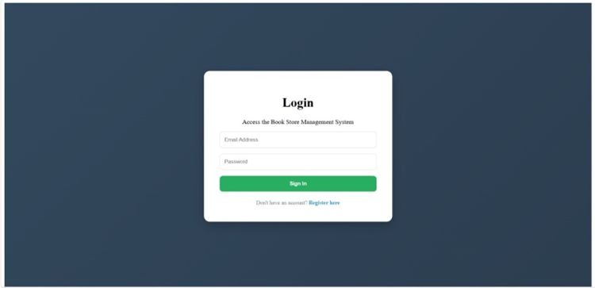
Online Book Store (Catalog Management System)
Login Page:
Allows users and admins to log in using email and password.
Validates credentials using backend REST APIs
2024 - RPS Consulting all rights reserved

Slide 16
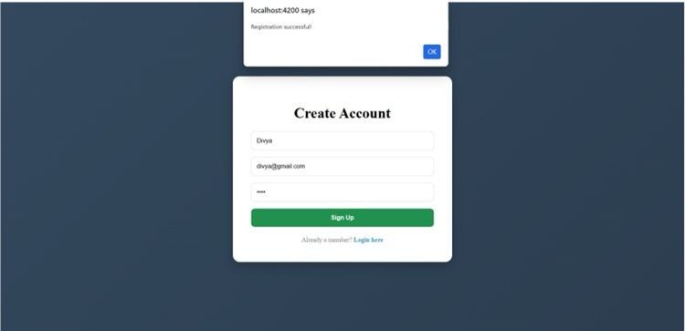
Online Book Store (Catalog Management System)
Registration Success Message:
Shows confirmation after successful registration. Improves user feedback and usability
2024 - RPS Consulting all rights reserved

Slide 17
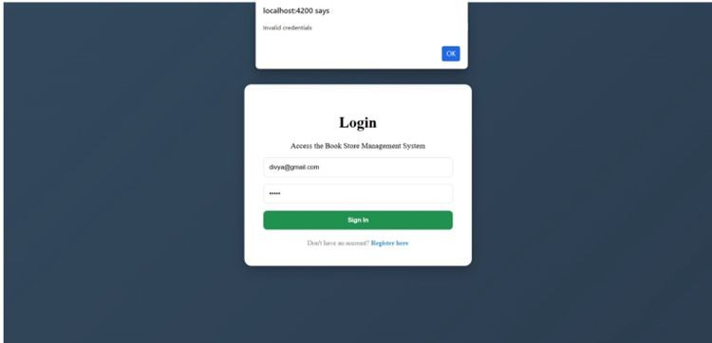
Online Book Store (Catalog Management System)
Invalid Login Message:
Displays error message for wrong credentials. Handled using proper validation and error
2024 - RPS Consulting all rights reserved

Slide 18
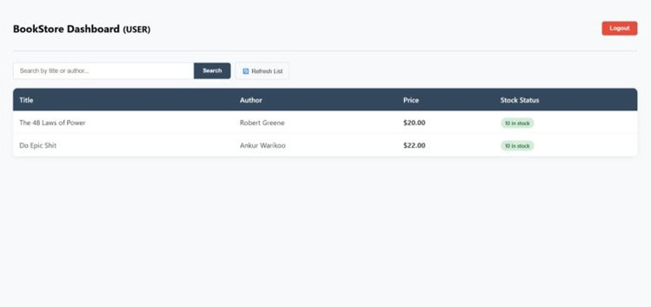
Online Book Store (Catalog Management System)
User dashboard :
Users can view available books with price and stock. Users can search books by title or author
2024 - RPS Consulting all rights reserved

Slide 19
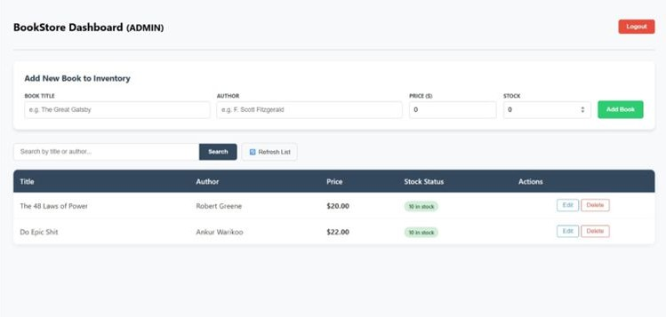
Online Book Store (Catalog Management System)
Admin dashboard :
2024 - RPS Consulting all rights reserved

Slide 20
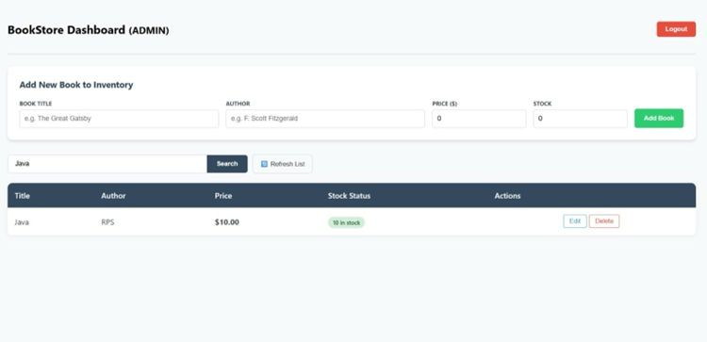
Online Book Store (Catalog Management System)
Admin –Add New Book:
Admin can view the complete book list
2024 - RPS Consulting all rights reserved

Slide 21
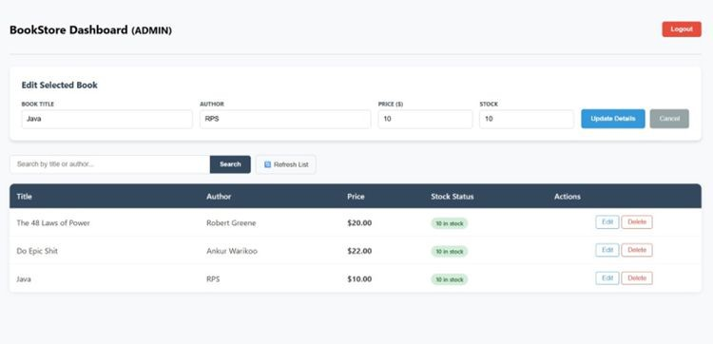
Online Book Store (Catalog Management System)
Admin – Edit Book :
Admin can update book title, author, price and stock. Changes are updated in the database using REST APIs.

Slide 22
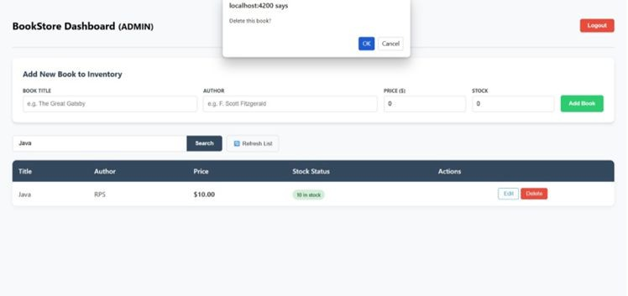
Online Book Store (Catalog Management System)
Admin – Search and Delete Book:
Admin can search books by title or author.
Admin can delete a book with confirmation dialog.

Slide 23
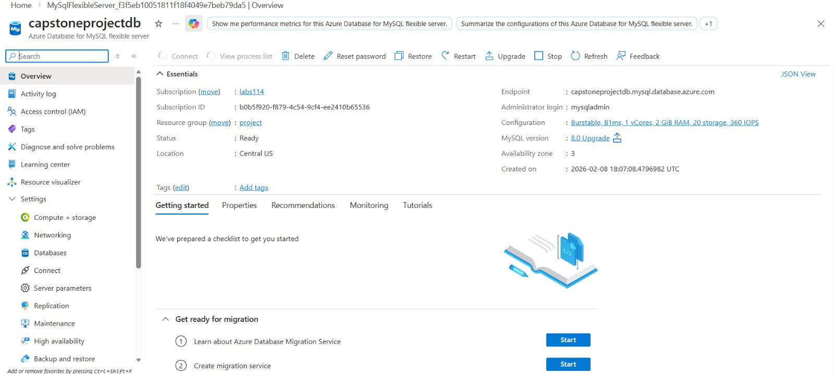
Online Book Store (Catalog Management System)
Database Service on Azure:
2024 - RPS Consulting all rights reserved

Slide 24
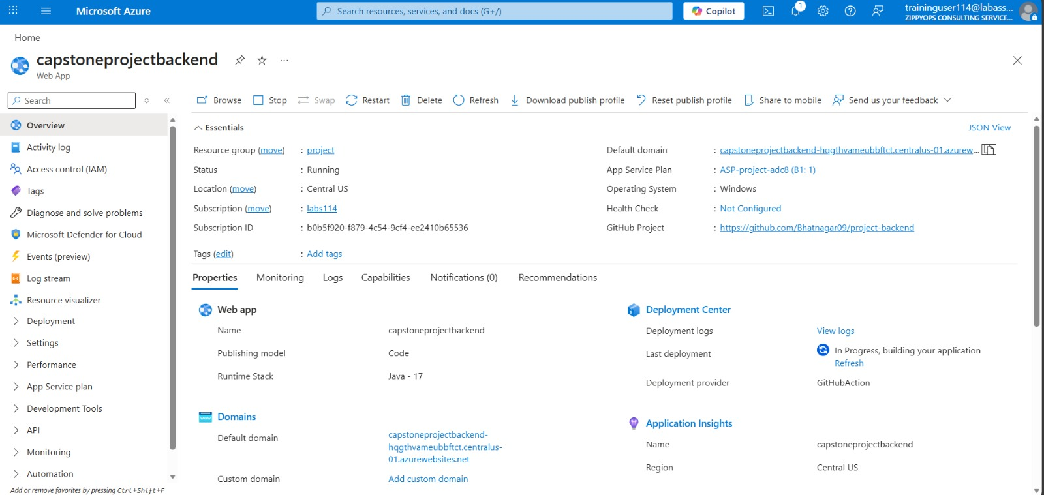
Online Book Store (Catalog Management System)
Backend on Azure:
2024 - RPS Consulting all rights reserved

Slide 25
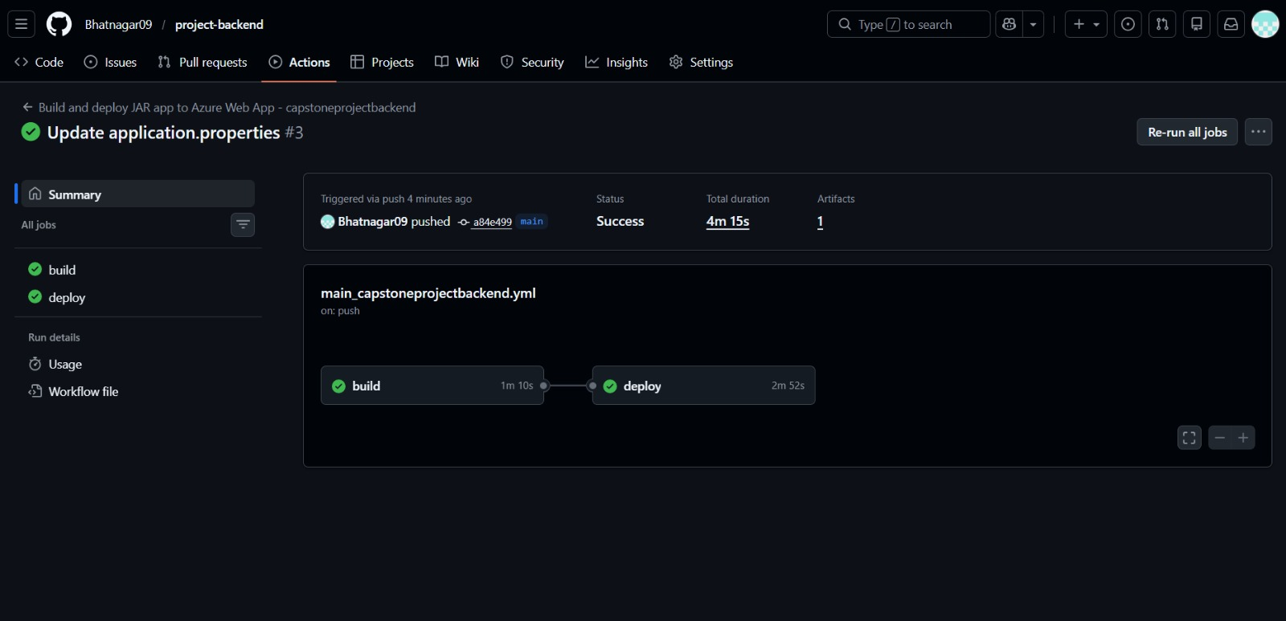
Online Book Store (Catalog Management System)
Backend on Azure:
2024 - RPS Consulting all rights reserved

Slide 26
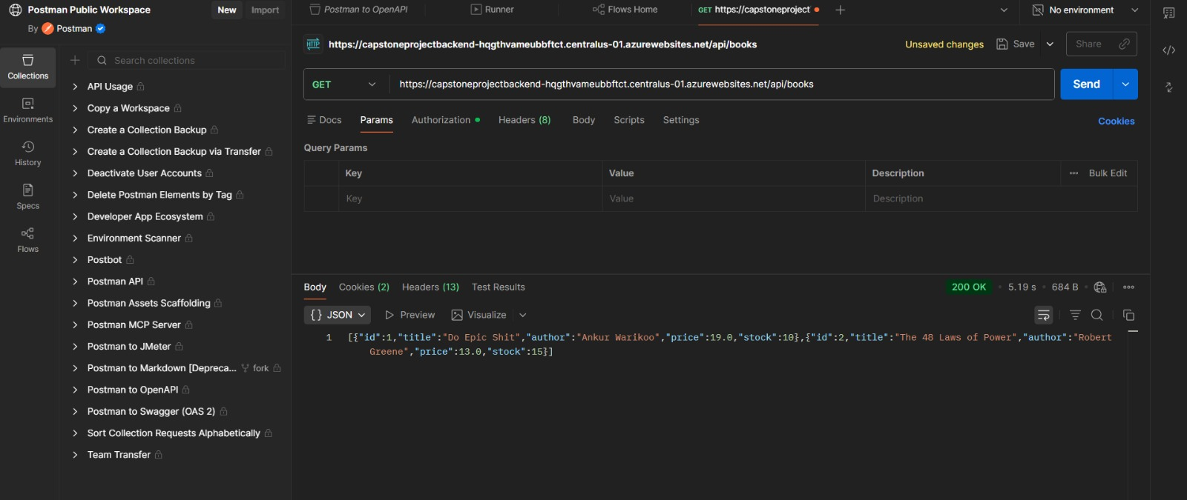
Online Book Store (Catalog Management System)
Backend on Azure:
2024 - RPS Consulting all rights reserved

Slide 27
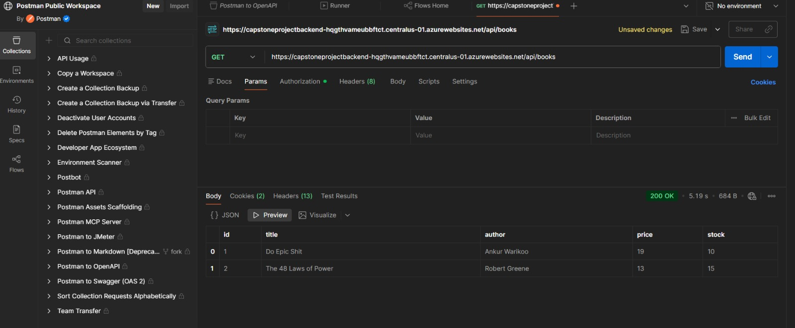
Online Book Store (Catalog Management System)
Backend on Azure:
2024 - RPS Consulting all rights reserved

Slide 28
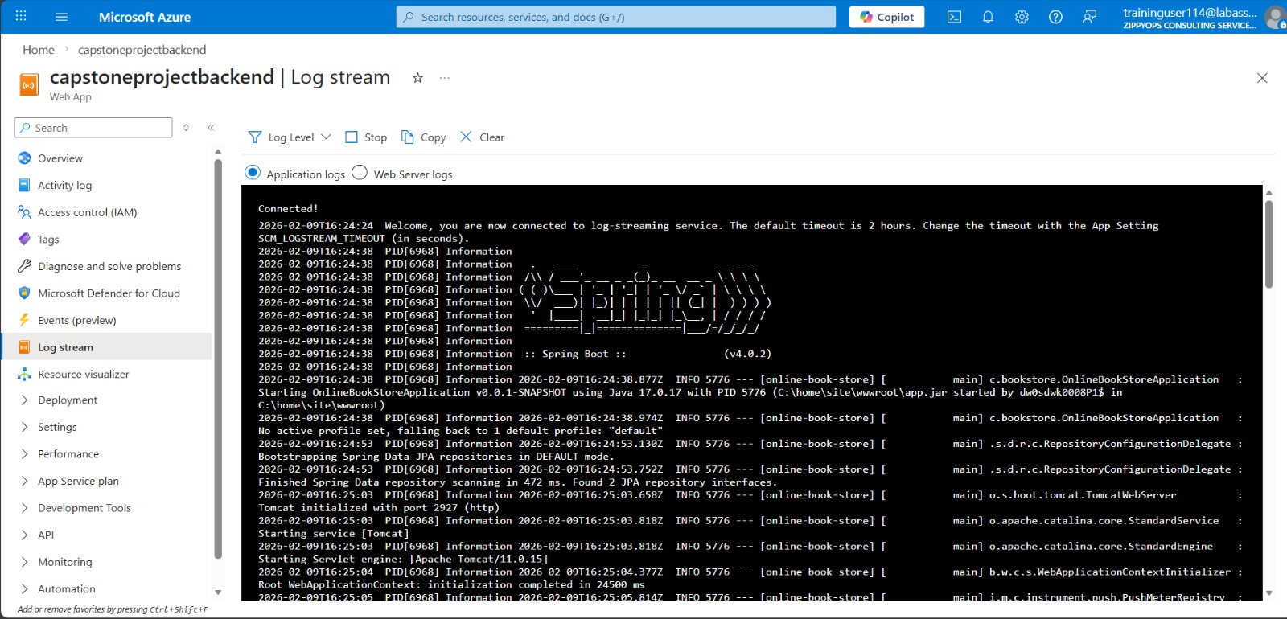
Online Book Store (Catalog Management System)
Backend on Azure:
2024 - RPS Consulting all rights reserved

Slide 29
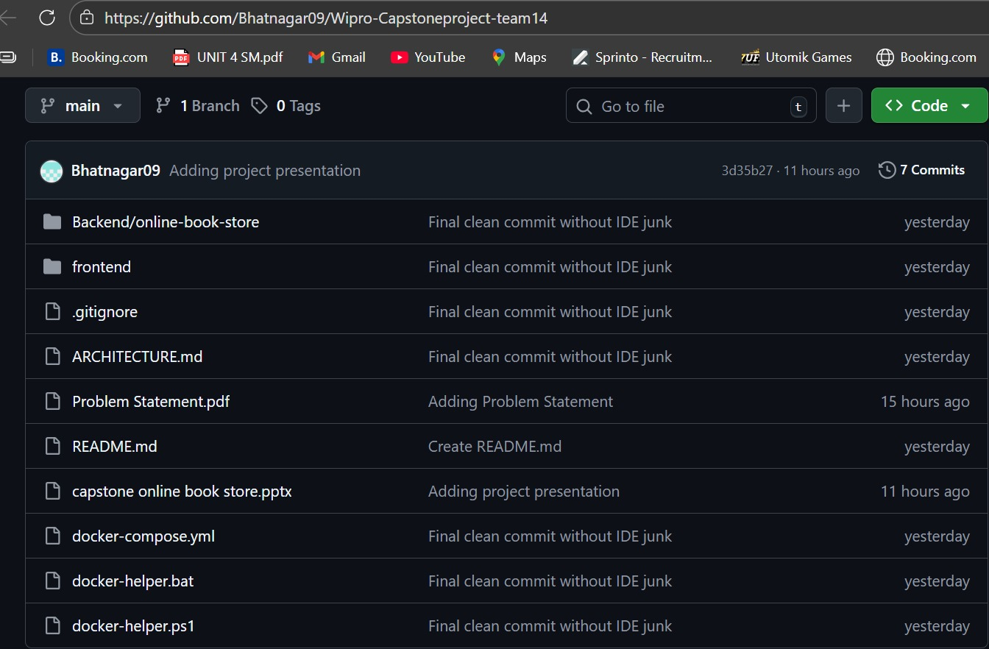
Online Book Store (Catalog Management System)
GitHub URL’s:
Pranav Bhatnagar(58684) -github url: https://github.com/Bhatnagar09/Wipro-Capstoneproject-team14.git
2024 - RPS Consulting all rights reserved

Slide 30
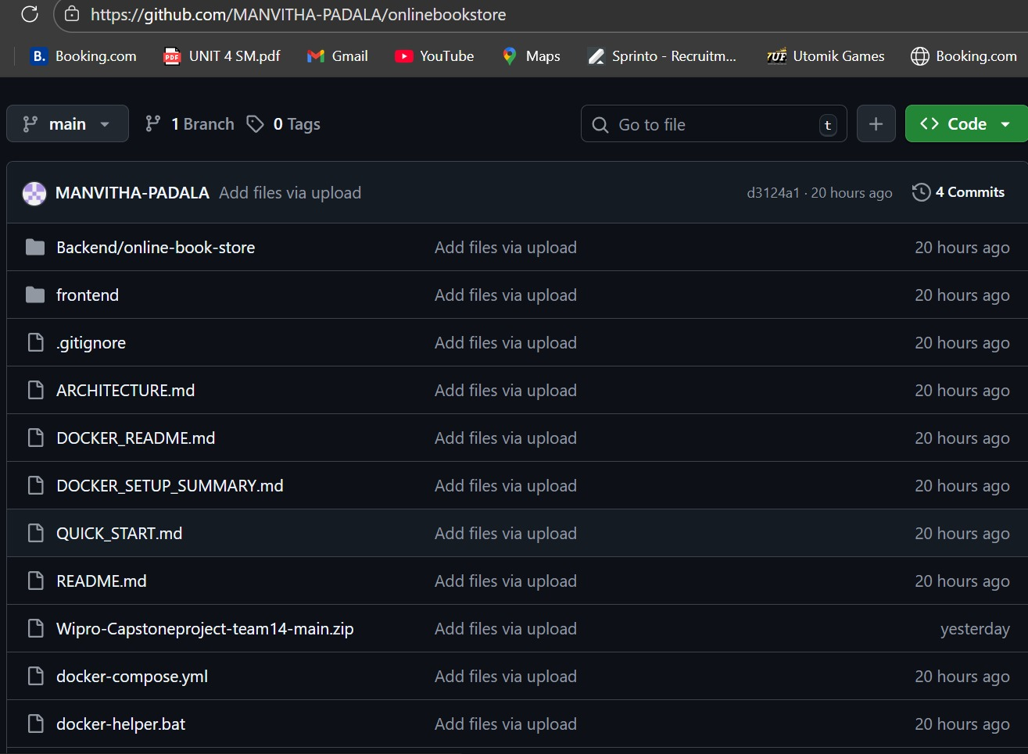
Online Book Store (Catalog Management System)
GitHub URL’s:
Padala Manvitha(58679)- https://github.com/MANVITHA-PADALA/onlinebookstore
2024 - RPS Consulting all rights reserved

